Slide 1

Passerelles numériques
A Gateway for Life
Routing
Controller
View

Slide 2

Outline
Routing
Controller
Blade

Slide 3
Basic Routing
Start “Hello world” for your first App.

Slide 4
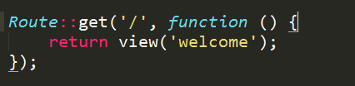
Basic Routing
Basic routing is meant to route your request to an appropriate controller. The routes of the application can be defined in routes/web.php file.
/ will define a default route
Notes:
Try to change some code in side the default rout such as change return view to echo hello world.
Route::post()
Route::delete()
For restfull api

Slide 5
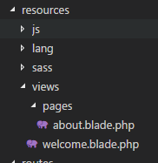
Route to view subfolder
Route::get('/about',function(){
return view('pages.about');
});

Slide 6
Routing Parameters
Required Parameters
Optional Parameters

Slide 7
1. Required Parameters
These parameters must be present in the URL. For example, you may intend to capture the ID from the URL to do something with that ID.
Route::get(test/{id}',function($id){ echo 'ID: '.$id;
});

Slide 8
2. Optional Parameters
There are some parameters which may or may not be present in the URL and in such cases we can use the optional parameters. The presence of these parameters is not necessary in the URL.
Route::get('/user/{name?}',function($name = Romdoul'){
echo "Name: ".$name;
});

Slide 9

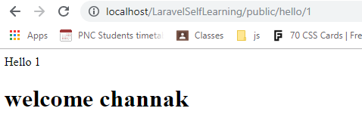
Activity

Slide 10
Controller
Introduction
Basic Controller

Slide 11
Introduction
Instead of defining all of your request handling logic in a single web.php file, you may wish to organize this behavior using Controller classes.
Controllers can group related HTTP request handling logic into a class. Controllers are typically stored in the app/Http/Controllers directory.

Slide 12
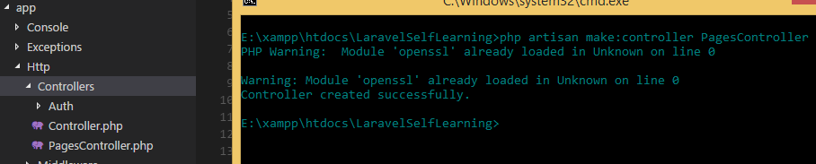
Create controller
Open command window enter
php artisan make:controller ControllerNames

Slide 13
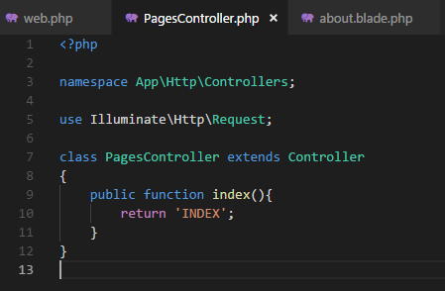


Create function in controller
In web.php of routes folder
Open url

Slide 14
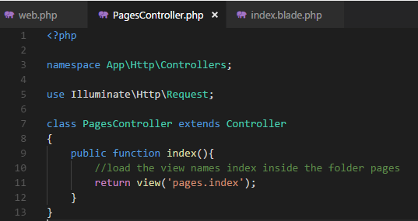
Load view from controller
Notes:
<title>{{config('app.name','LaraSelf')}}</title>
Title of the index.blade.php: it means take the app.name from .env if no value give LaraSelf

Slide 15
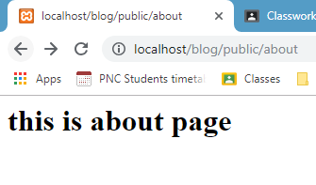
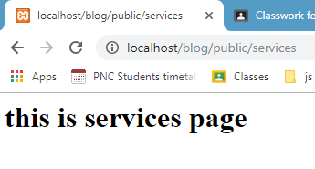
Activity: 15mn
Create two views inside pages folder
about: there is a heading1 saying “this is about page”
services: there is a heading1 saying “this is service page”
Create two methods inside PagesController
about() to return view about
services() to return view services
Then create route to call these methods

Slide 16

Question?
Google.com

Slide 17
View:blade https://laravel.com/docs/5.7/blade

Slide 18
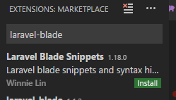
Install blade snippet
To highlight blade syntax
Ctrl + Shift + x to open extention and search for laravel blade snippet
Or Ctrl+P and type: ext install laravel-blade
Hit install
Then reload after the installation finished

Slide 19
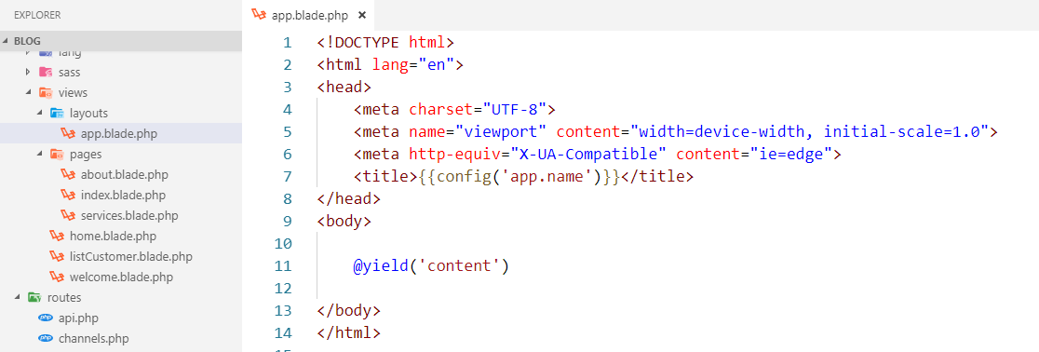
Make app.blade layout

Slide 20
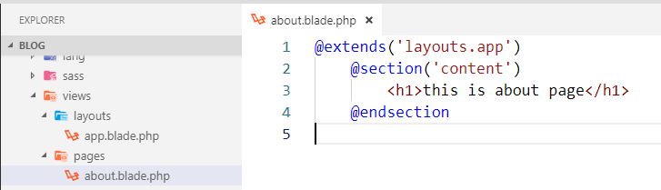
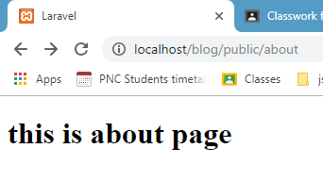
Extend the app.blade

Slide 21
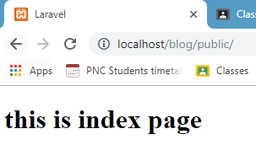
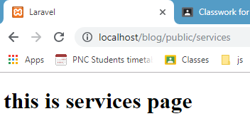
Activity#1: 10mn
Try to extend this app.blade.php for other two views: index and services

Slide 22
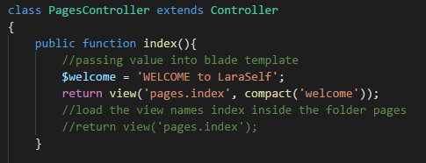
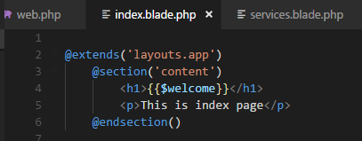
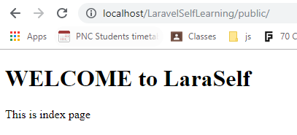
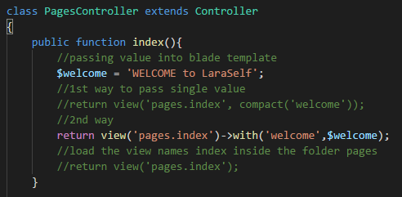
Passing value into blade template
1st way
2nd way

Slide 23
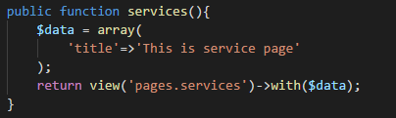
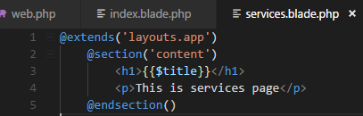
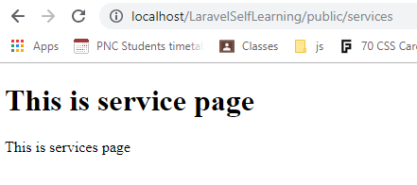
Passing associative array
Controller
View

Slide 24
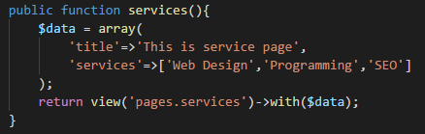
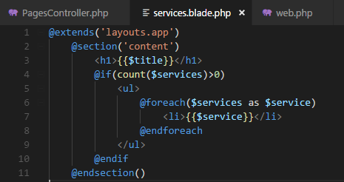
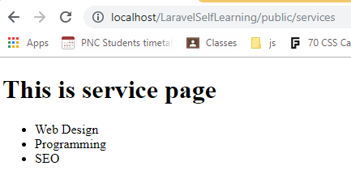
Passing associative array
Controller
View

Slide 25
Activity#2: 15mn
We have this array represent the list of customer
$data = array(
'0'=>array('id' => 1,'name' => 'Chandaraty','email' => 'chandaraty@example.org'),
'1'=>array('id' => 2,'name' => 'Maly','email' => 'maly@example.org'),
'2'=>array('id' => 3,'name' => 'Samphas','email' =>'samphas@example.org'),
'3'=>array('id' => 4,'name' => 'Donat','email' => 'donat@example.org')
);

Slide 26
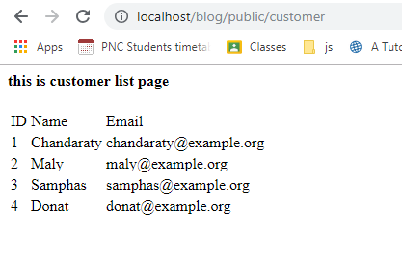
Activity#2: 15mn
Create a method inside the PageController to show all the customer information into view listCustomer

Slide 27

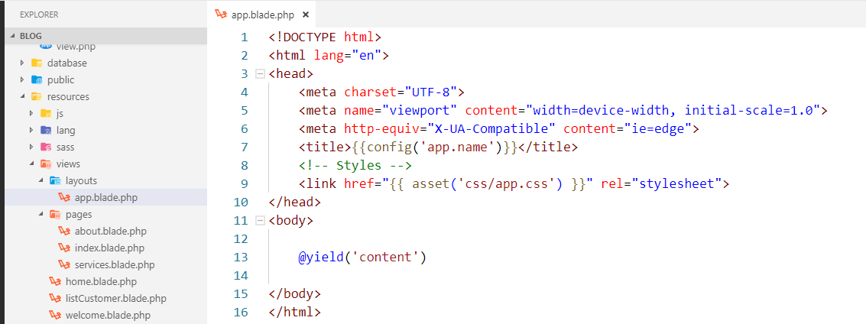
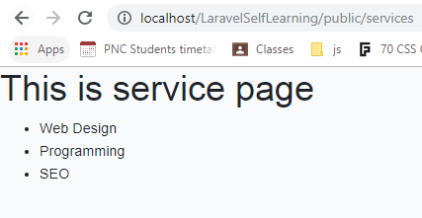
Assets folder
Include bootstrap by default
Notes:
Public is the compile version

Slide 28
If we want to use our own css
Search

Slide 29
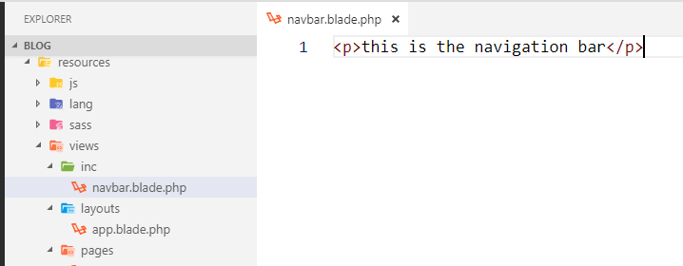
Add navigation bar
Create navbar.blade.php in inc folder then include it into app.blade.php
Notes:
@include is just like a basic PHP include, it includes a "partial" view into your view.
@extends lets you "extend" a template, which defines its own sections etc. A template that you can extend will define its own sections using @yield, which you can then put your own stuff into in your view file.

Slide 30
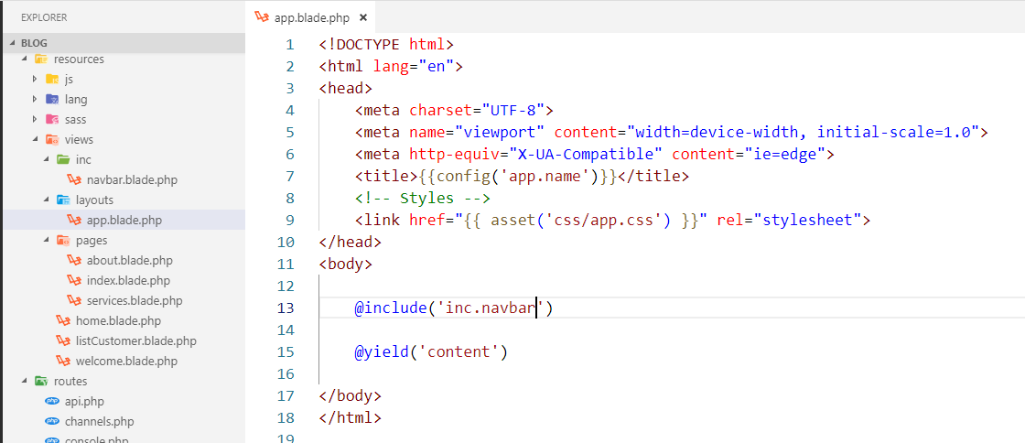
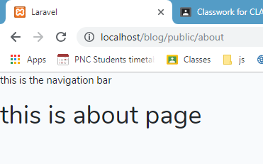
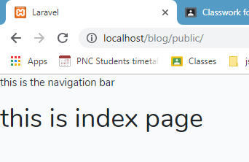

Slide 31
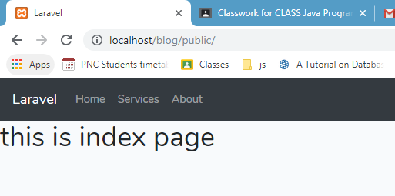
Activity#3: 15mn
Create a nice navigation bar using bootstrap and make the link to all the three view: index, about and services
Notes:
<nav class="navbar navbar-expand-sm bg-dark navbar-dark">
<ul class="navbar-nav">
<li class="nav-item">
<a class="navbar-brand" href="#">{{config('app.name')}}</a>
</li>
<li class="nav-item">
<a class="nav-link" href="{{url('')}}">Home</a>
</li>
<li class="nav-item">
<a class="nav-link" href="{{url('services')}}">Services</a>
</li>
<li class="nav-item">
<a class="nav-link" href="{{url('about')}}">About</a>
</li>
</ul>
</nav>

Slide 32
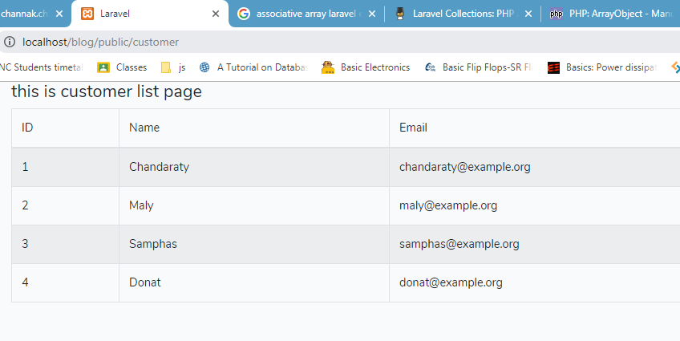
Activity#4: 15mn
Try to make the list customer into this look

